Slide 1


Send in-app notifications within model-driven apps (preview)
Presented BY:
Anshika Agrawal (IGD-Biz apps)

Slide 2
Agenda
Introduction
Notification Entity – Key Points
Enable Send- In App Notification in Model Drive App
Generate Notifications
Icon Types
Actions
Including Styles, Custom Icon and URL in Notification
Control Navigation
Security Role Configuration
How to Generate Team level Notifications ?
Different Use Case Scenarios
Validate your Notification Request Call

Slide 3
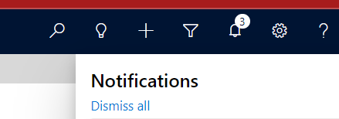
Introduction
In existing D365 applications, we have notification entity which can be used to create notification record and we can customize it to show it on to the screen.
With this new feature, everything is given by OOB system. We can create notification record by simple webapi call and user will be notified in a separate section.
We have multiple options which we can use while creating a new notification like adding styles, new line, custom icon, Links between text etc.
To explore more, we will create some notifications by applying different styles in upcoming slide.
Note: Currently this feature is in preview mode and not available in all regions.

Slide 4
Notification Entity – Key Points
We have Notification entity and logical name is ‘appnotification’.
Owner of the Notification record will receive the notification.
If we want to create notification for multiple user, then we must create record for each user.
We can also set the expiry of the Notification.
Model driven app automatically checks for new notification record and show the notification in the Notification center. Notification appear in the Notification center until user dismiss it or it expires.

Slide 5
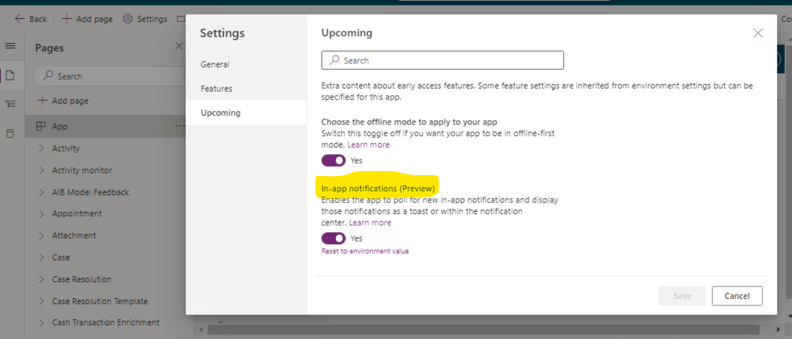
Enable in-App Notification Feature
Login to the maker portal
Select the specific environment and the solution where the model driven app is present
Edit the model driven app in preview mode and update the settings as shown

Slide 6
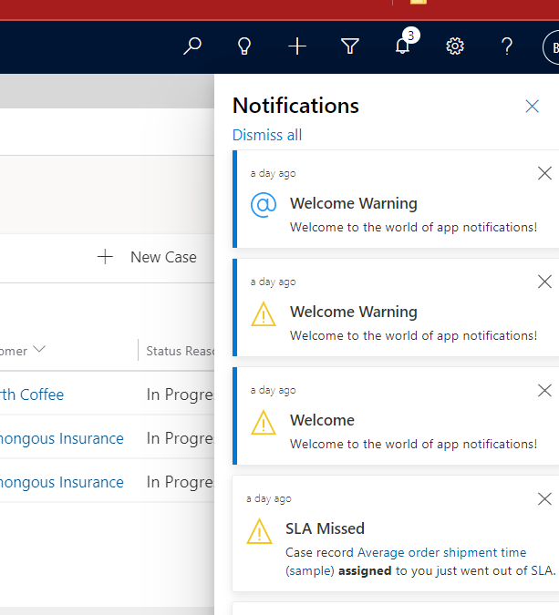
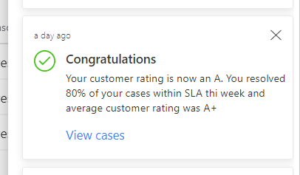
Notification View

Slide 7
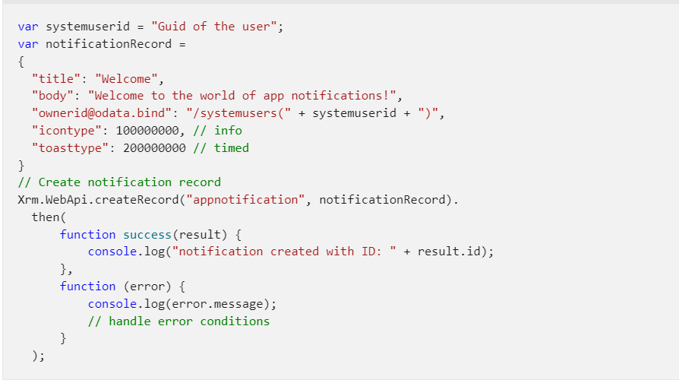
Generate Notifications
This will be owner of the notification record.
Some icons are available by default, and we can also add custom icon.
2 Types : Timed and Hidden
Toast : It appears as a toast notification
Hidden : This will only appear in notification center.
XRM WEB API Call to create Notification record
Default expiry time is 14 days. It should be mentioned in seconds.

Slide 8
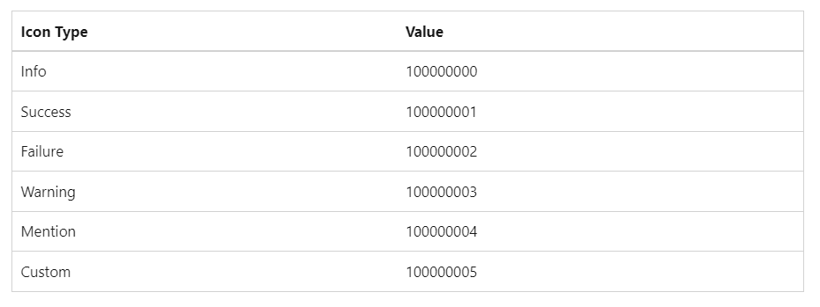
Icon Types
We can create a web resource file which will be pointing to a custom image, and we can use this icon for our notification.

Slide 9
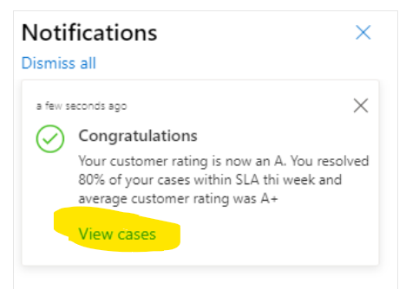
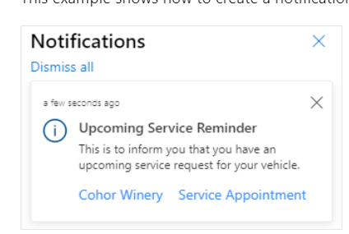
Actions
We can add single or multiple actions.
Actions are the URL’s which will navigate us to the specific mentioned entity/page.
To include actions in the notification, we must add data attribute and actions inside the data.

Slide 10
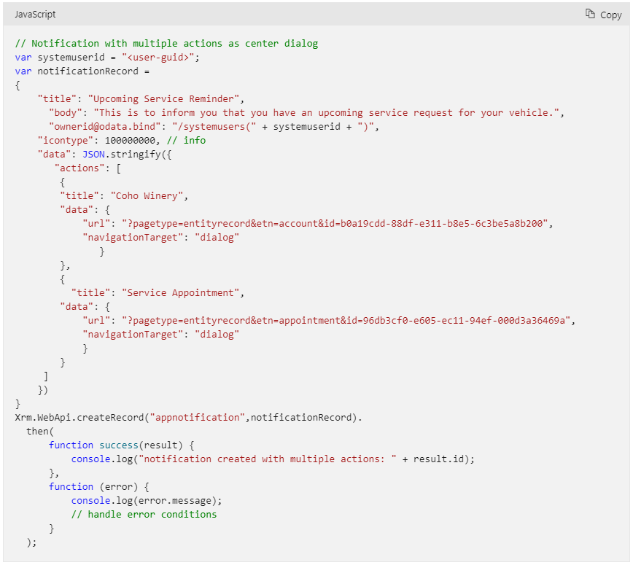
We have added 2 actions here
We can specify URL for the action

Slide 11
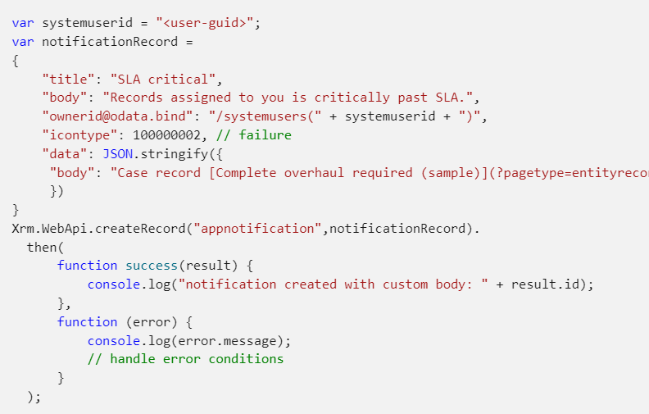
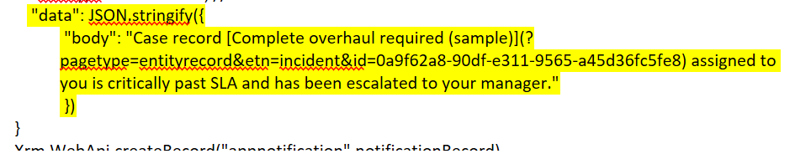
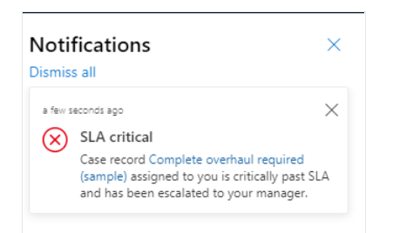
Including Styles, Custom Icon and URL in Notification
Add Hyperlink : To add the hyperlinks in the body, we must again mention body inside data attribute. It will have text and hyperlink which can mentioned as given below.

Slide 12
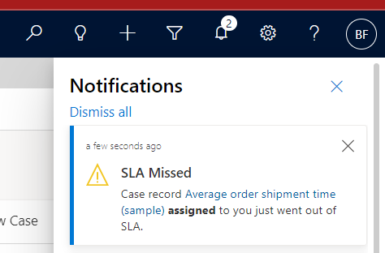
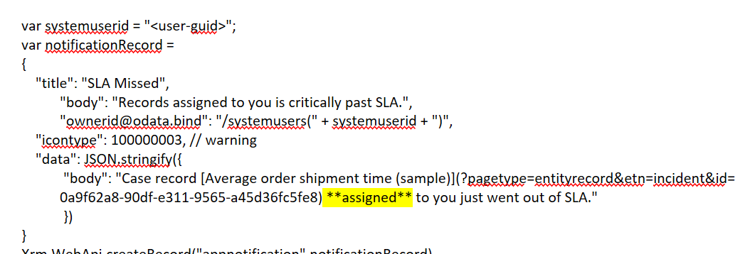
Including Styles, Custom Icon and URL in Notification
Add Bold : To add the bold in the body, we must again mention body inside data attribute and add letter inside **.

Slide 13
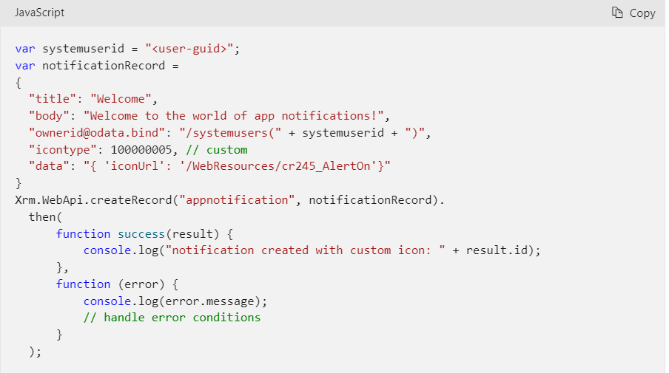
Including Styles, Custom Icon and URL in Notification
Add Custom icon : We have to set iconType to custom and in the body we can include iconUrl with value pointing to web resource.
Icon type set to custom
iconUrl pointing to web resource

Slide 14
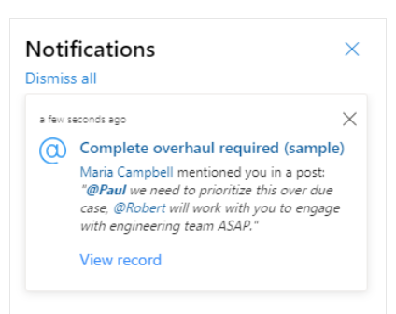
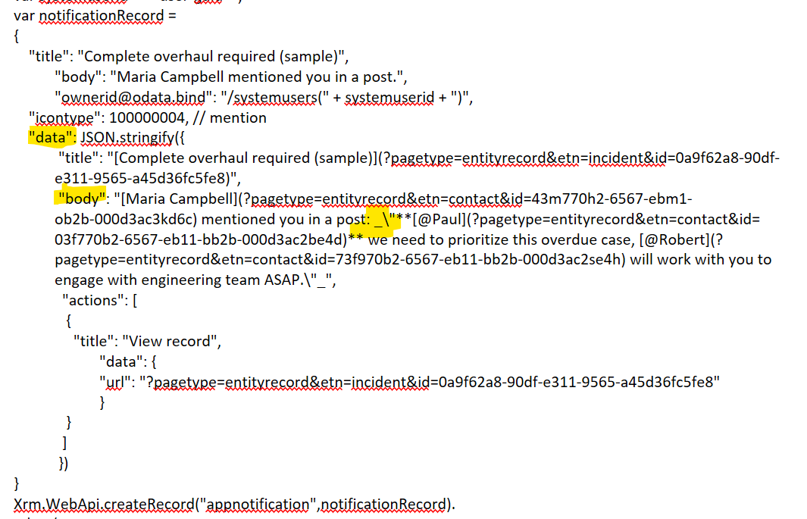
Including Styles, Custom Icon and URL in Notification
Add New Line : _\

Slide 15
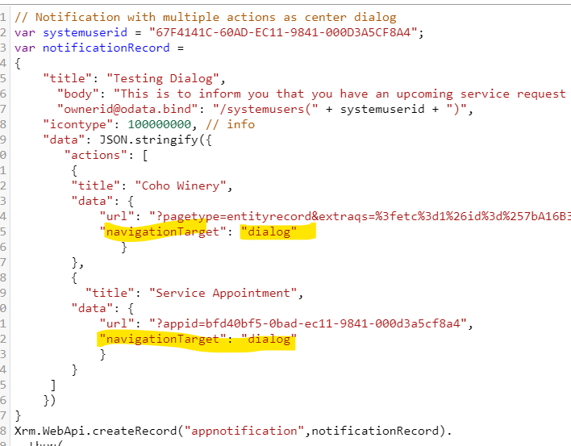
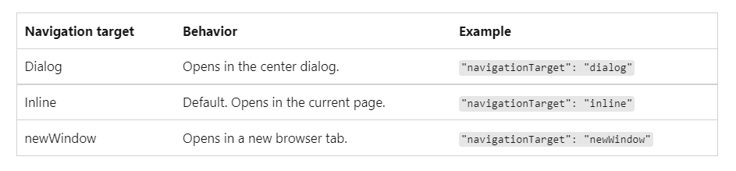
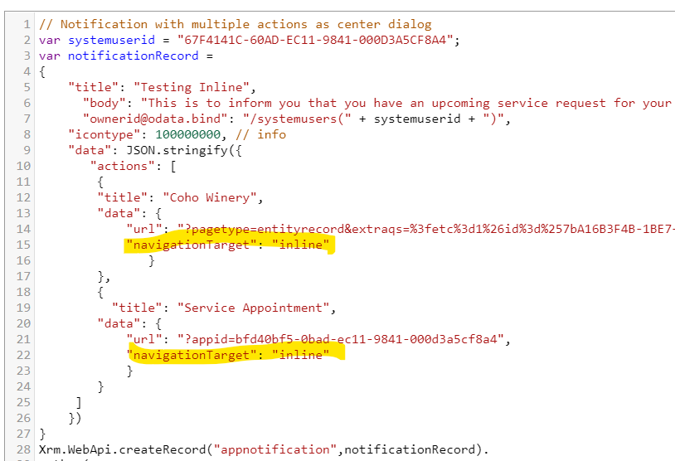
Control Navigation

Slide 16
Security Role Configuration
A non-admin user should be having the below privileges to access the notification records:
Notification Entity - User level Create, Read on Notification Entity
Model Driven App User Setting – Org level Create, Read, Write, and Append
Setting Definition – Org Level Read and AppendTo

Slide 17
How to Generate Team level Notifications ?
Currently the D365 OOB Notification does not support team notification
To achieve this we can adopt a work-around
Get a separate Entity created called Team Notifications where the record owners will be the Teams
Create individual notifications through an azure function or any other batch process whenever an owner notification is created. This batch function will create individual records for all team members under OOB Notification Entity

Slide 18
Different Use Case Scenarios
Notifications can be used for different purpose within a project. Currently we are handling something very specific to our projects which are:
Queue Mentions Notifications
Case Flagged Risky Notifications
Case Transferred notifications
Broadcast Notifications
Case Update Notifications

Slide 19
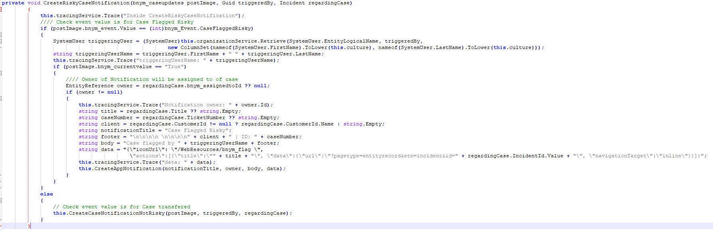
Code Snippet

Slide 20
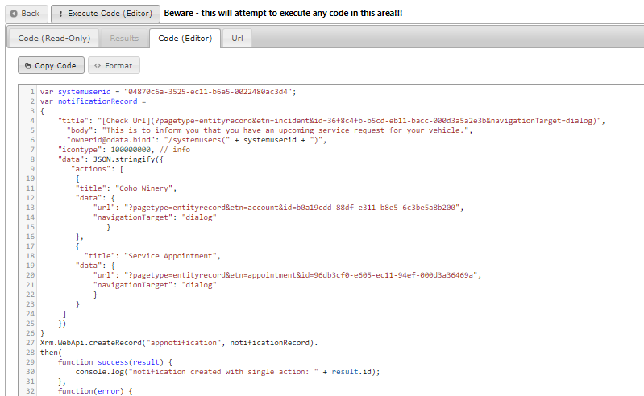
Validate your Notification Request Call

Slide 21

Resource
https://docs.microsoft.com/en-us/power-apps/developer/model-driven-apps/clientapi/send-in-app-notifications

Slide 22

Thank You

